Slide 1
NSCC MSD/MSS

Slide 2
MSS - Money Settlement Statement
System employed by the NSCC in order to settle all services used by it’s participants
Each service is documented separately
for example, Mutual Funds are separate from IPS
The MSS allows the NSCC participants to consolidate all their financial obligations through 1 single transaction, saving on time and money

Slide 3
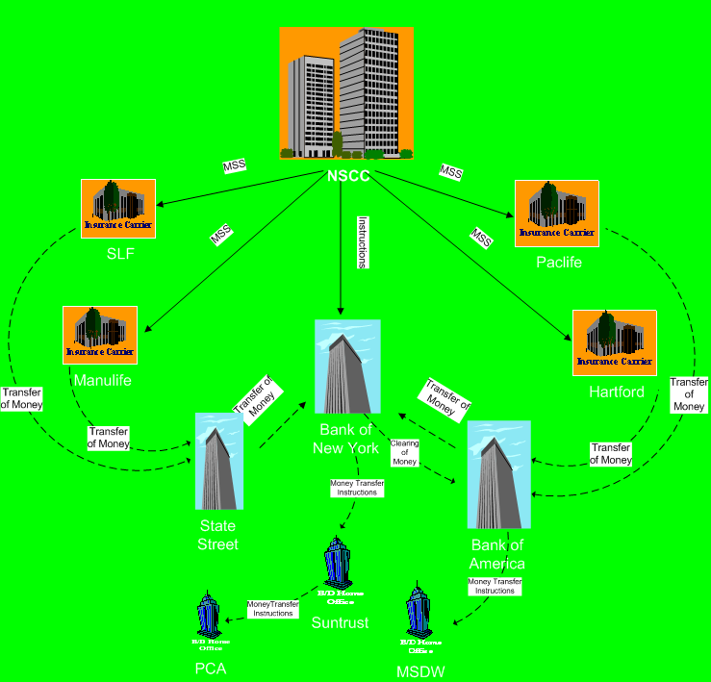
Money Settlement Process

Slide 4
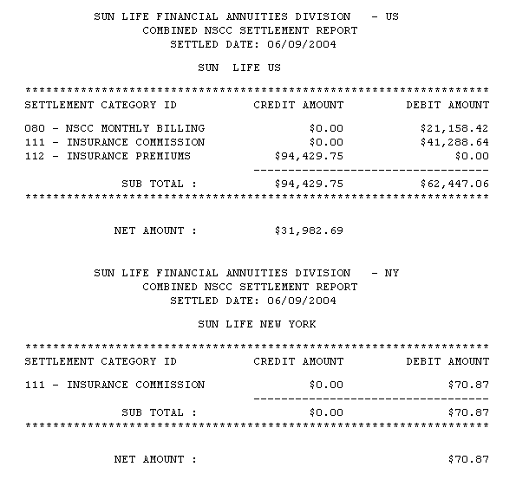
MSS Report
Below is a sample of a Combined NSCC Settlement Report
MSS Report for
Carrier
MSS Report for
Carrier New York

Slide 5
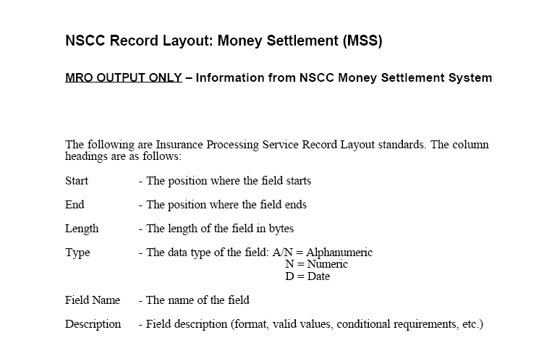
MSS Layout

Slide 6
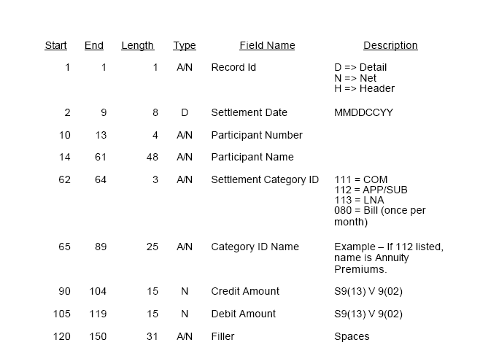
MSS Layout

Slide 7
Current Functionality: Money Settlement Detail ( MSD )
Generated by NSCC to interface to Money Settlement System (MSS)
Detailed output to both carrier and broker
MSD output generated at 12:00PM-COM, 2:30PM-APP/SUB
One aggregate amount daily to Money Settlement
Settlement with banks at approximately 5:00 PM
Settlement does not occur on NY Bank holidays. Settlement moves to next business day.

Slide 8
Settling Bank
Settling Bank
Each participant appoints a “Settling Bank” to act on it’s behalf, with regard to taking money from the Clients account, in order to settle a statement
At about 4pm EST, the clearing corporation makes final settlement figures available to the participant’s settling bank
At 4.30pm, the Settling Banks acknowledge the figures.
The actual settling of debits and credits by the Settling Bank takes place at around 5pm that same day

Slide 9
MSD - Money Settlement Detail
MSD is a subset of the MSS (Money Settlement Statement)
It supplies the details of the IPS settlement, and informs the carriers and distributors on that day’s money activity, specific to IPS (Insurance Processing System)
There are 2 MSD files, 1 containing all relevant Commission information, the other containing all relevant Initial Premium and Subsequent Premium settlement information

Slide 10
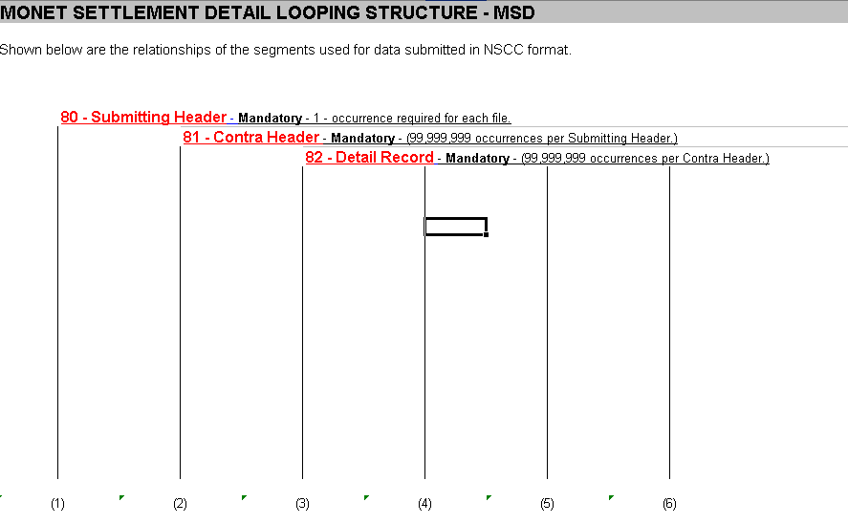
MSD – Looping Structure

Slide 11
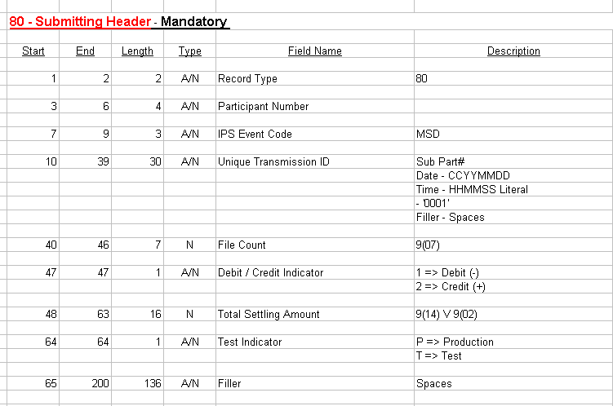
MSD – Record Layout

Slide 12
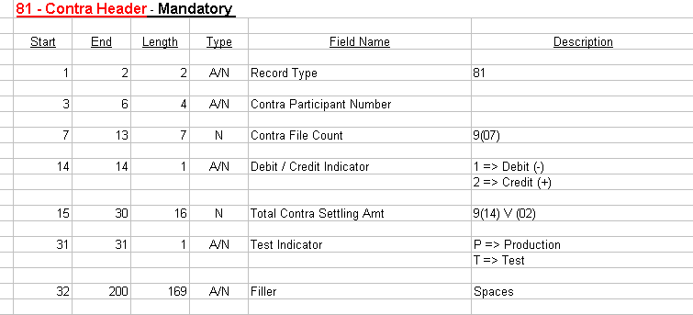
MSD – Record Layout

Slide 13
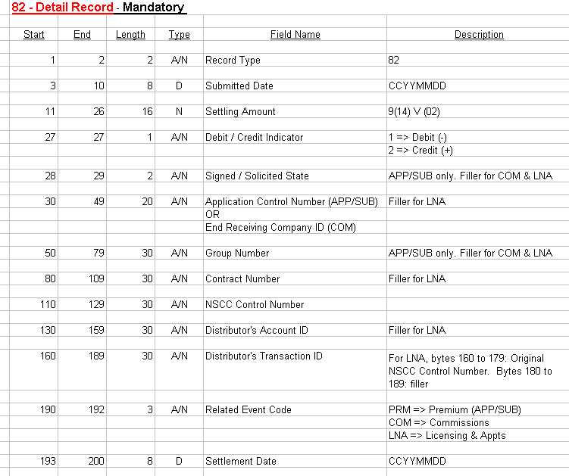
MSD – Record Layout

Slide 14
MSS - Money Settlement Statement
System employed by the NSCC in order to settle all services used by it’s participants
Each service is documented separately
for example, Mutual Funds are separate from IPS
The MSS allows the NSCC participants to consolidate all their financial obligations through 1 single transaction, saving on time and money

Slide 15
MSS Report
Below is a sample of a Combined NSCC Settlement Report
MSS Report for
Carrier US
MSS Report for Carrier New York

Slide 16
MSS Layout

Slide 17
MSS Layout

